Slide 1
UNIT 3
Probability

Slide 2
Suppose a student is selected at random from 100 students where 30 are taking mathematics, 20 are taking chemistry, and 10 are taking mathematics and chemistry. Find the probability p that the student is taking mathematics or chemistry.

Slide 3
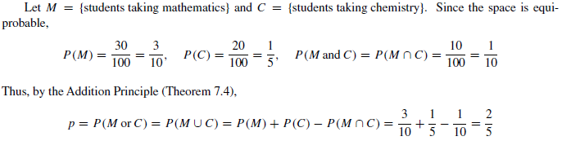
Suppose a student is selected at random from 100 students where 30 are taking mathematics, 20 are taking chemistry, and 10 are taking mathematics and chemistry. Find the probability p that the student is taking mathematics or chemistry.

Slide 4

CONDITIONAL PROBABILITY
Suppose E is an event in a sample space S with P(E) > 0.
The probability that an event A occurs once E has occurred or, specifically, the conditional probability of A given E.
Written P(A|E), is defined as follows:

Slide 5
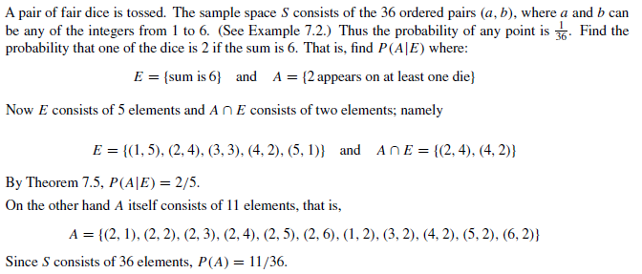

Slide 6
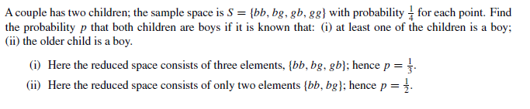

Slide 7


Slide 8

A lot contains 12 items of which 4 are defective. Three items are drawn at random from the lot one after the other. Find the probability p that all three are non-defective.
The probability that the first item is non-defective is 8/12 since 8 of 12 items are non-defective.
If the first item is non-defective, then the probability that the next item is non-defective is 7/11 since only 7 of the remaining 11 items are non-defective.
If the first 2 items are non-defective, then the probability that the last item is non-defective is 6/10 since only 6 of the remaining 10 items are now non-defective.
Thus by the multiplication theorem,

Slide 9

INDEPENDENT EVENTS
Events A and B in a probability space S are said to be independent if the occurrence of one of them does not influence the occurrence of the other.
More specifically, B is independent of A if P(B) is the same as P(B|A).
Now substituting P(B) for P(B|A) in the Multiplication Theorem P(A ∩ B) = P(A)P (B|A) yields

Slide 10

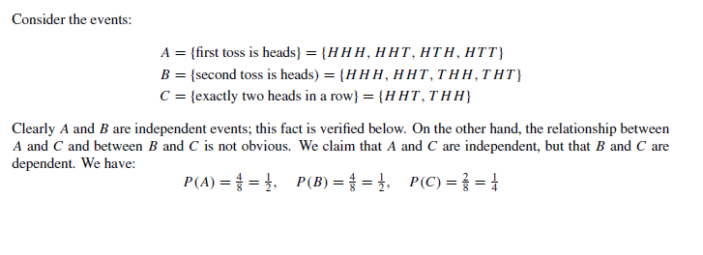

Slide 11
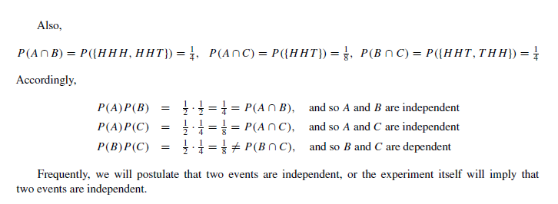

Slide 12

The probability that A hits a target is 1/4, and the probability that B hits the target is 2/5. Both shoot at the target. Find the probability that at least one of them hits the target, i.e., that A or B (or both) hit the target.
We are given that P(A) = 1/2 and P(B) = 2/5, and we seek P(A∪ B). Furthermore, the probability that A or B hits the target is not influenced by what the other does; that is, the event that A hits the target is independent of the event that B hits the target, that is, P(A ∩ B) = P(A)P (B). Thus

Slide 13
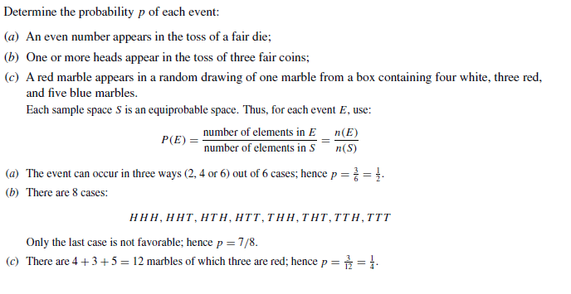

Slide 14
A single card is drawn from an ordinary deck of 52 cards. Find the probability p that the card is a:
(a) face card ( jack, queen or king);
(b) heart;
(c) face card and a heart;
(d) face card or a heart.
Here n(S) = 52.

Slide 15
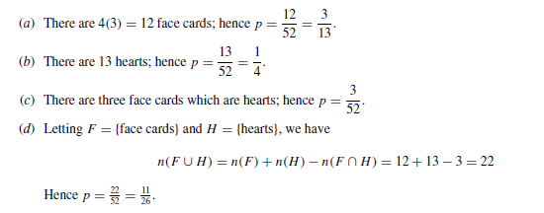

Slide 16
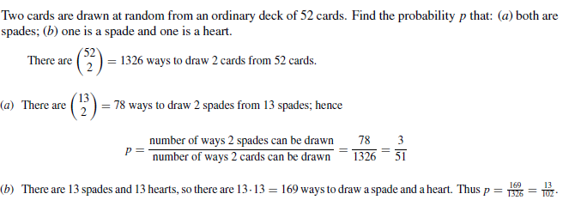

Slide 17


Slide 18
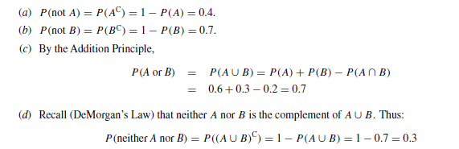

Slide 19
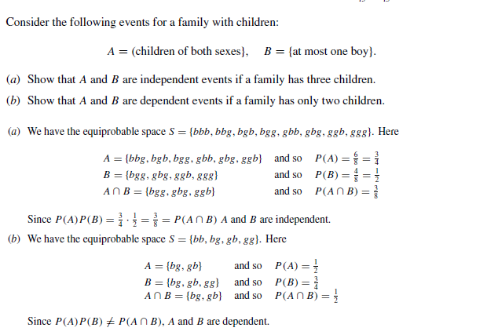

Slide 20
Statistical inference
Statistical inference is the process of extracting information about an unknown variable or an unknown model from available data.
Two main approaches
Bayesian statistical inference
Frequentist statistical inference

Slide 21
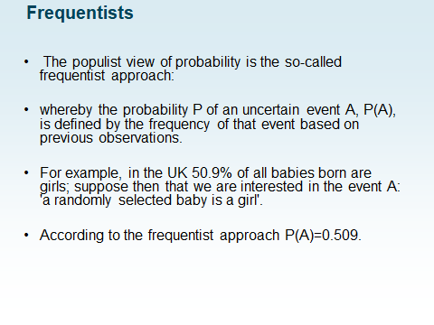
frequentist inference

Slide 22
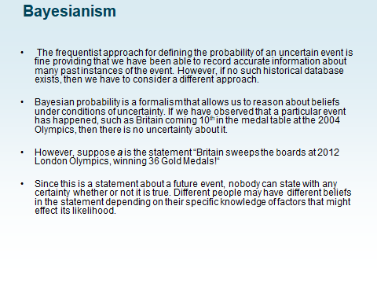
bayesian inference

Slide 23
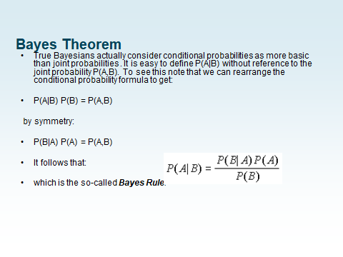

Slide 24
There are 52 cards in the pack, 26 of them are red and 26 are black. What is the probability of the card being a 4 given that we know the card is red?
P(B|A) = P(red|4) = 1/2
P(A) = P(4) = 4/52 = 1/13
P(B) = P(red) = 1/2
ANS: 1/13

Slide 25
The probability of a certain medical test being positive is 90%, if a patient has disease D. 1% of the population have the disease, and the test records a false positive 5% of the time. If you receive a positive test, what is your probability of having D

Slide 26
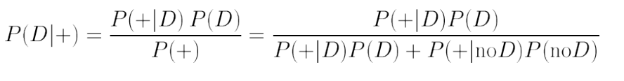
P(+|D)=0.9, P(D)=0.01, P(+|no D)=0.05, we want P(D|+)
Substituting in the numbers : P(D|+) = 0.15

Slide 27
In a factory there are two machine manufacturing bolts. The first machine manufactures 75% of the bolts and the second machine manufactures the remaining 25%. From the first machine 5% of the bolts are defective and from the second machine 8% of the bolts are defective. A bolt is selected at random, what is the probability the bolt came from the first machine, given that it is defective?

Slide 28
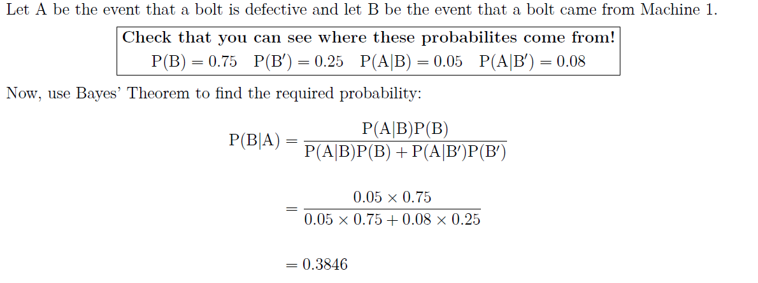

Slide 29
An ice cream vendor sells three flavors: chocolate, strawberry, and vanilla. Forty five percent of the sales are chocolate, while 30% are strawberry, with the rest vanilla flavored. Sales are by the cone or the cup. The percentages of cones sales for chocolate, strawberry, and vanilla, are 75%, 60%, and 40%, respectively. For a randomly selected sale, define the following events:
A1 = chocolate chosen
A2 = strawberry chosen
A3 = vanilla chosen
B = ice cream on a cone
BC = ice cream in a cup

Slide 30
Find the probability that the ice cream was sold on
a cone and was
a) chocolate flavor
b) strawberry flavor
c) vanilla flavor

Slide 31
ANSWERS:
a) P(B and A1) = P(B/A1).P(A1) = (0.75)(0.45) =0.3375
b) P(B and A2) = P(B/A2).P(A2) = (0.60)(0.30) = 0.18
c) P(B and A3) = P(B/A3).P(A3) = (0.40)(0.25) = 0.10

Slide 32
Find the probability that the ice cream was sold in a cup and was chocolate flavor
ANSWERS:
P(BC and A1) = P(BC /A1).P(A1) = (0.25)(0.45) = 0.1125
Find the probability that the ice cream was sold on a cone.
ANSWER:
P(B) = P(B and A1) + P(B and A2) + P(B and A3) = 0.3375 + 0.18 + 0.10 = 0.6175
Find the probability that the ice cream was sold in a cup.
ANSWER:
P(BC ) = 1 – P(B) = 1 – 0.6175 = 0.3825

Slide 33
Find the probability that the ice cream was chocolate flavor, given that it was sold on a cone
ANSWER:
P(A1 /B) = P(A1 and B) / P(B) = 0.3375 / 0.6175 =
0.5466
Find the probability that the ice cream was chocolate flavor, given that it was sold in a cup
ANSWER:
P(A1 /BC ) = P(A1 and BC ) / P(BC)
= 0.1125 / 0.3825 = 0.2941

